Slide 1
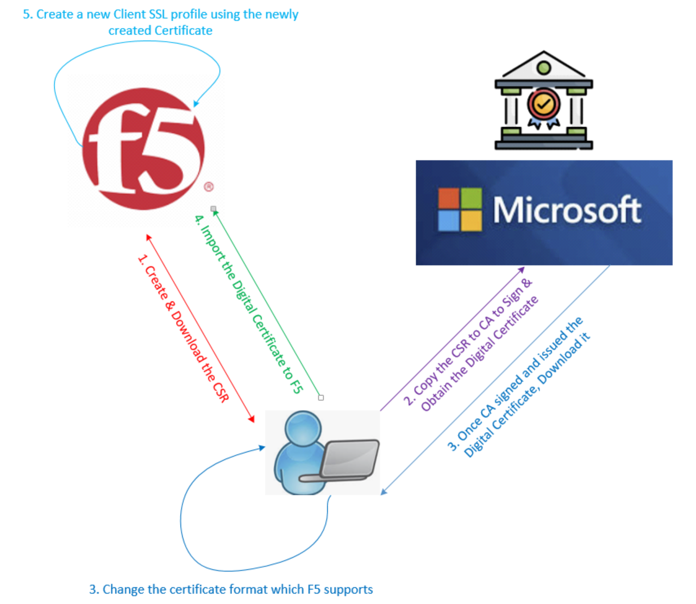
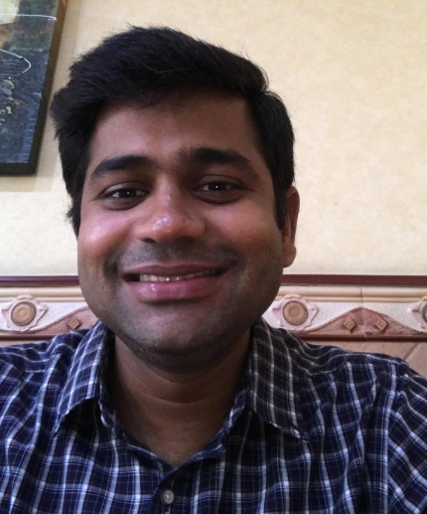
F5 LTM Learning with Alexander S
Bonus Chapter 02 – Create CA-Signed Certificate & Configure Client SSL Profile

Slide 2
LAB - Prerequisites
A Root Certificate Authority (CA) – Available to issue certificates for lab.ae domain hostnames
Required the access to the F5 TMOS GUI
LTM Module should be provisioned with appropriate license.
Required the Virtual Server Hostname – auth.lab.ae

Slide 3
Five steps to complete this LAB
Step 01 : Create & Download the CSR for virtual server hostname auth.lab.ae
Step 02 : Copy the CSR to Certificate Authority to Sign & Obtain the Digital Certificate.
Step 03 : Download and Change the certificate format which F5 supports
Step 04 : Import the virtual server certificate bundle in to F5
Step 05 : Configure the new Client SSL profile using the newly Created Certificate.

Slide 4
Step 01 : Create & Download the CSR for virtual server hostname auth.lab.ae
Access to the F5 GUI
Create the CSR for auth.lab.ae
Download the CSR

Slide 5
Step 02 : Copy the CSR to Certificate Authority to Sign & Obtain the Digital Certificate.
Access the Root-CA URL
Submit the CSR to Root CA
Get the CSR signed by Root CA
Root CA sign the CSR and issues the Digital Certificate.
Download the Digital Certificate.

Slide 6
Step 03 : Download and Change the certificate format which F5 supports
.p7b format is not suitable for F5
F5 need .cer or .pem
Download the CSR
Prepare the F5 supported Certificate format

Slide 7
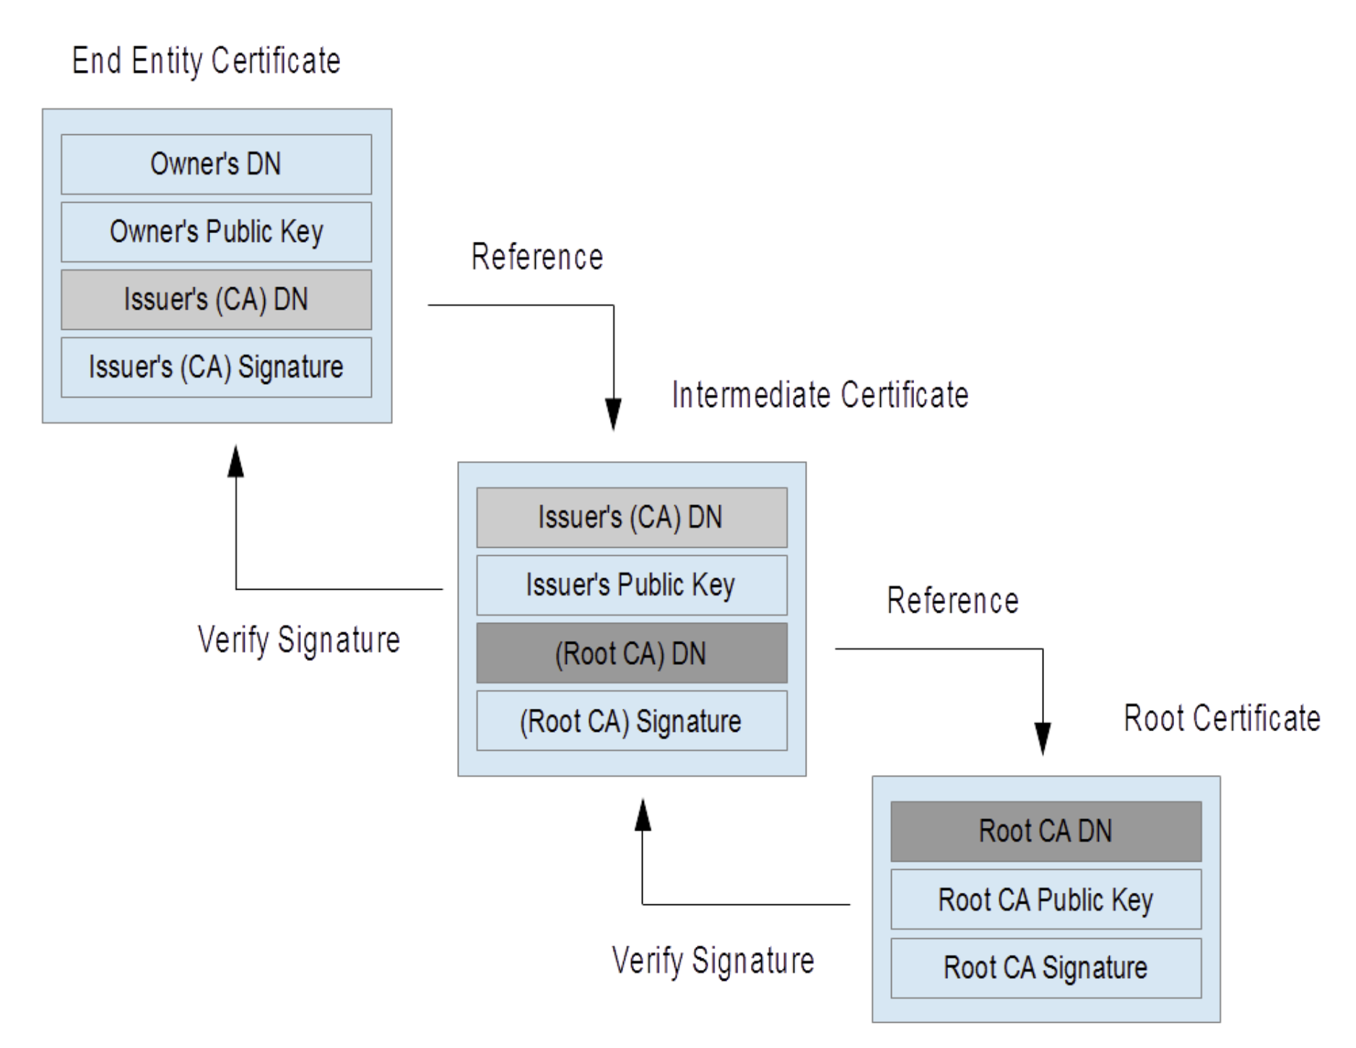

Step 03 : Change the certificate format which F5 supports
General F5 Web Server (Virtual Server) Certificate Bundle Format
We do not have intermediate Certificate!!!
Our Web (Virtual) Server Certificate Format

Slide 8
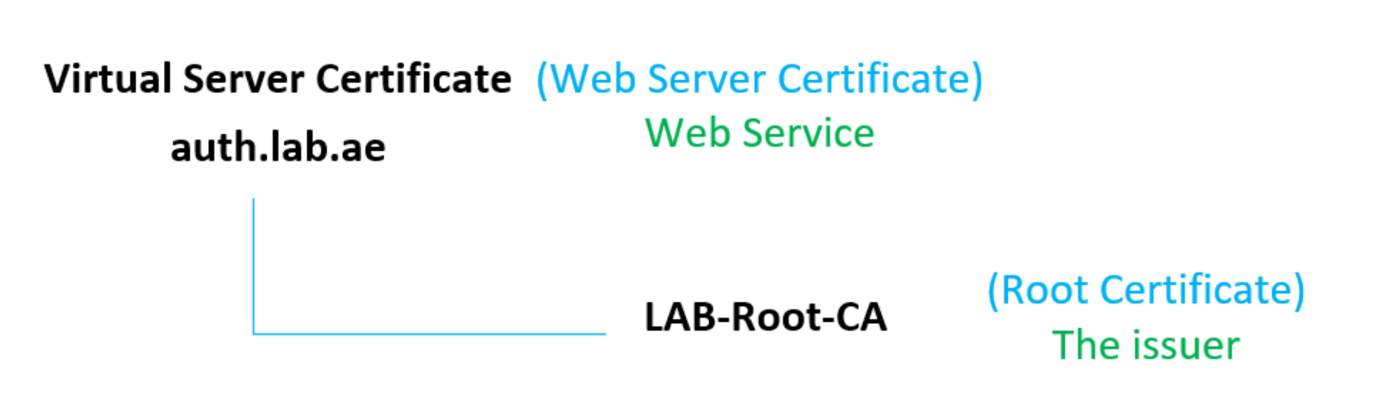
Step 03 : Change the certificate format which F5 supports
Our Web (Virtual) Server Certificate Format

Slide 9
Step 04 : Import the virtual server certificate bundle in to F5

Slide 10
Step 05 : Configure the new Client SSL profile using the newly Created Certificate
Choose the certificate & Key
Choose the Cipher

Slide 11
Step 05 : Configure the new Client SSL profile using the newly Created Certificate
Chain Certificate Not Required.
The BIG-IP system now allowed chain certificates in the same file as the SSL server certificate

Slide 12
This concludes Bonus Chapter 02. In this lab, we successfully created a CA-signed certificate and configured the Client SSL Profile on F5. Thank you for watching!

